Slide 1
Enabling QEC@IBM Challenge – QEC Framework and GUI
Drew Vandeth, Andrew Cross
QEC@IBM

Slide 2
Enabling QEC Challenge
“The better the QEC, the more successful
the Quantum Computing Company”
Successful Commercial
Quantum Computing
The difficulty and complexity of the QEC problem is likely too much for any one team of researchers.
Quantum Computer
How to take advantage of this state?
Scale
Errors
Efforts towards QEC technologies will significantly increase as the number of physical qubits increases
Competition for QEC people will increase
Both secrecy within and cooperation amongst competing groups will be necessary in order to advance quickly
QEC@IBM

Slide 3
Problems to Consider
How to attract and maintain the best QEC researchers?
How to share with competitors to advance QEC technologies quickly enough while maintaining significant commercial lead on our competitors?
How to obtain maximal knowledge of the QEC research community and have a significant degree of passive control?
How to accelerate QEC research with fixed resources?
How to accelerate the transfer of QEC research technologies into experimental and commercial environments?
How to make Qiskit the primary tool for the QEC community?

Slide 4
Approach
Multiple opportunities for IBM
No such framework currently exists
Provide services, capabilities, and infrastructure to enable people to learn, communicate, experiment, and research QEC with significantly less effort.
Enable Qiskit and associated external libraries to become the de facto software framework for QEC worldwide.
Significantly raise the global profile of QEC@IBM with the goal of having IBM being recognized as the leading organization for QEC research.
QEC Software Framework (include GUI)
Collaboration and Discovery for QEC
QEC Datasets and Utilities
QEC Knowledge Community
Only sparsely available and not organized
Significant gaps and focused on specific communities

Slide 5
FT QEC Summer School
IBM Organizers: Andrew Cross, Tomas Jochym-O’Connor, Drew Vandeth Academic Organizers: People being approached
Currently Funding: $0.5M # Students: 40-60 # Participants: 100-200
Participation from participants and speakers
Participation from across the community
~6 weeks
2-3 weeks
~6 weeks
Content Preparation
Wk1/2: QEC Fundamentals
Wk2: QEC Focus Topics
Post Content
Study (Focus on technical content understanding)
Support via slack and other mediums
Support via slack and other mediums
Initial bonding of participants
Background Study
Post Collaboration (Focus on Open Problems and new collaborations)
Offers of visits to supporting institutions for continued collaboration or via online
Deep bonding of participants
Lecture Notes
Videos to watch
Algebra, Topology,…
Papers or Books to Read
Quantum Foundations
Classical Error Correction
Focus on known problems
Focus on open problems
Focus on Theory and Computation
Focus on one or two specific advanced topics

Slide 6
FT QEC Summer School
The QEC Book
Lecture Chapters
Qiskit Chapters
QEC Framework Needed
Question Chapters
Video Chapters
Integrated Units

Slide 7
‘The QEC Book’
Eminence for those that write Class A Articles
Hybrid between an ‘author ownership’ and ‘no author’ approach
If successful could grow to the larger field of quantum computation …
Class A Article Groups
Dynamic, written from multiple perspectives and multiple backgrounds
Class B Article Groups
Journal Articles
Published Books
Qiskit code for core + articles …

Slide 8
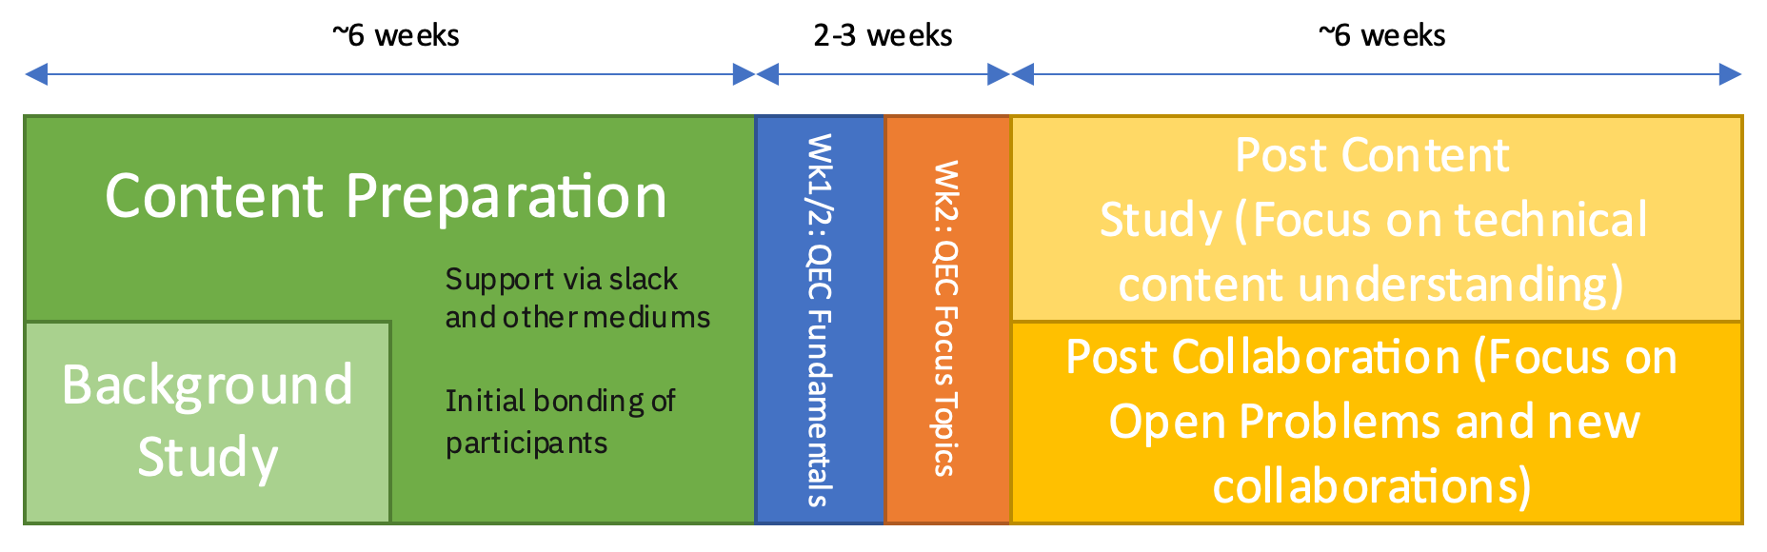
Schedule (partial):
2020
2021
J
J
A
S
O
N
D
J
F
M
A
M
J
J
A
S
School
QEC Lecture Notes/Book Dev
Qiskit Chapter Dev
1st QECF Dev
~8 months
2nd QECF
~6 months
3rd
~1.5 months
4th
Partial release of Framework
Beta release of Framework Call for contributors

Slide 9
QEC Software Framework
Our goal should be to provide a software framework for QEC which is as frictionless to the user as possible.
The QEC framework functionally should exist beyond the Qiskit, Python and C/C++ framework.
Three basic considerations are 1) speed and ease of development; 2) scale of computations; and 3) speed of computations.
Ability to experiment with new ideas quickly
‘Quickly’ reproduce published results
Interacts with common systems – MatLab, GAP, …
Experimentally or abstractly
Simulation
Decoder S
Decoder T
Noise A
QECC X
Logical Operators
Interchangeable modules
Noise B
QECC Y
Logical Operators

Slide 10
QEC Software Framework
Viewpoints:
Original Approach:
Python for representations
C++ for computations
Initial 3 month with interns to produce a prototype framework. Then pull in larger team to build the actual framework
Focus on subsystem codes
Issues:
High profile and expected success of school means that high standard for initial beta release.
Expected timeline shorter than originally thought
Workload for robust general code extensive (code +doc)
QEC Development
Quantum Algorithmic Development
High Programming Level
Compiler or HW level
Current approach
Streams:
Core Framework (CLI) – Python
Core Framework (CLI) – C++
GUI Framework – 2D
GUI Framework – 3D

Slide 11
Key Areas of Discussion
Data Representation
Object Interfaces
Distribution problems
Architecture, Syntax and Qiskit integration
(Efficient) Logical Operations
Lattice Surgery
Code Deformation
Gauge Fixing
(Braiding)
Error Analysis, Propagation, …

Slide 12
GUI
2D Codes
Logical Operators
Error Propagation
3D Codes
Scheduling
Error Analysis

